Slide 1
AIR POLLUTION:
A COMPREHENSIVE PLAN ISSUE ?
PARTICULATE MATTER:
WHAT YOU CAN’T SEE CAN MAKE YOU VERY SICK
Submitted by George Papadi, Alachua County, FL EPAC member Nov. 5, 2017

Slide 2
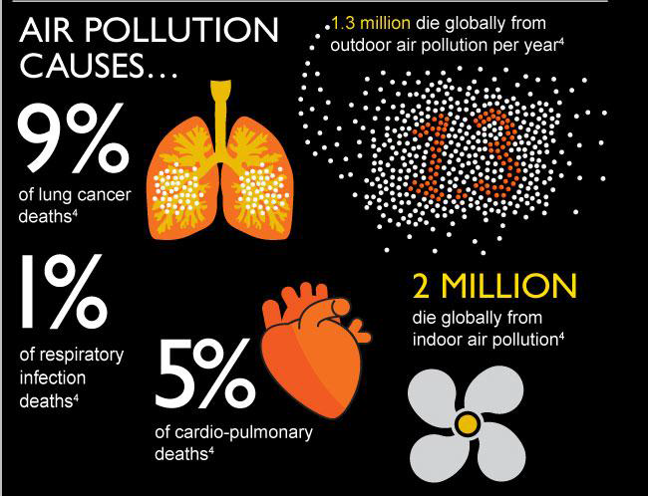
Harvard School of Public Health, “Epigenetic Changes Through Air Pollution – Hyang-Min Byun 2014
Notes:
Hyang-Min Byun, PhD, Res Scientist, Harvard School of Public Health, “Epigenetic Changes Through Air Pollution - 2014

Slide 3
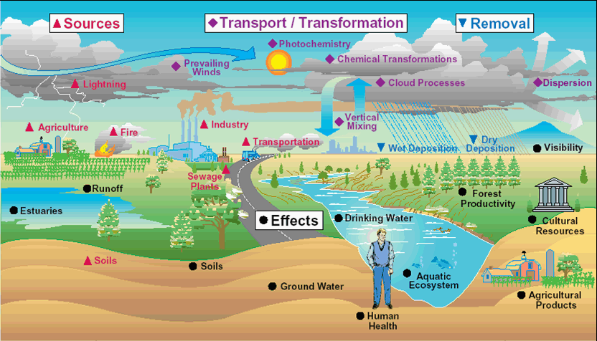
Pollution Circulates Globally
Pollution Sources: Industrial, Trains, Vehicles,& Agricultural.
Causes of Circulation & Transformation: Weather, the Hydrological & Nitrogen Cycles, Photochemical Processes, Chemical Transformations)

Slide 4
WHAT ARE THE COMPONENTS OF AIR POLLUTION ?
Particulate matter– microscopic matter AKA atmospheric particulate matter, PM, or suspended particulate matter (SPM), can be solids or liquids or combinations of both.
Gaseous Contaminants
  VOC - Volatile organic compounds - e.g. benzene, formaldehyde, petroleum vapors, etc.
  PAH – Polycyclic aromatic hydrocarbons – e.g. –smoke from tobacco, wood fires, BBQ
  PIC - Particles of incomplete combustion - e.g. Exhaust hydrocarbons are toxic. Sources: coal, oil, wood, tires as fuel. Dioxin is among the most carcinogenic example of a PIC. PCBs induce prenatal cognitive deficits that persist into adolescence and beyond (J. Jacobsen, New England J. of Med. Oct. 1996). Smoke is composed of tiny solid, liquid, and gas particles that collectively include carbon (soot), tar, oils & ash. Soot particles produced in diesel engines are typically 15nm in diameter. Incomplete combustion occurs when the supply of air & O₂ is poor. Water is still produced, but CO & carbon are produced instead of CO_{2.}
  Vaporized metals that are all hazardous whether they are in gaseous liquid, or cooled in the form of ultrafine particles (UFP). These metals are chemically reactive and form a myriad of metabolically toxic compounds. e.g. mercury (Hg), zinc, (Zn), cadmium (Cd), chromium (Cr), magnesium (Mg), nickel (Ni), molybdenum ( Mb), manganese (Mn), aluminum (Al), titanium (Ti), cobalt (Co)
  Ozone (O₃)
  Oxidized & reduced forms of carbon: CO, CO₂, CH₄
  Oxides of nitrogen: NO, NO₂, N₂O_{4,} NH₃, NH⁴⁺ that combine with other chemicals.
  Oxides of sulfur: SO₂, sulfuric acid, alkali sulfates (contribute to the formation of fine particulates)
  Halides – Chlorine and fluorine compounds e.g. alkali chlorides (contribute to the formation of fine particulates)

Slide 5
Why does Particulate size Matter?
Why does the size matter when it pertains to health risks?
Answer: The smaller particulates are the easier it is for them to penetrate into places they don’t belong.
Fine particles (PM 2.5 um) - Lungs, digestive tract, exposed moist membranes of the nose, eyes, and urinary tract.
Ultra fine Particles (UFP ≤ 0.1um = 100nm) into the blood stream via the lung’s air sacs (alveoli); through the placenta and into the fetus; through the skin; up the nasal passages and into the brain via the olfactory nerve; into the brain via the blood stream by passing through the “blood-brain barrier”; into tissues such as muscle, peripheral nerves, and blood vessel walls; through cell membranes and into the cytoplasm, the nucleus and mitochondria of all cells everywhere in the body. Nothing can stop them!
What harm can they do? Answer: Act as toxins that either kill cells directly or produce inappropriate chemical reactions that change the function of cells and ultimately organ systems; cause localized tissue and systemic inflammation which leads to premature death from cancer, asthma, heart disease, diabetes, and is now connected even to Alzheimer's; disrupt the body’s ability to regulate normal process vital to short and long-term health; cause mutations; stimulates as well as suppresses normal gene function which results in the over or underproduction of proteins associated with our DNA.

Slide 6
History of Air Pollution Regulation & Specifically Particulates
1970 – Clean Air Act of 1970 – The EPA is created. A major amendment to the original 1963 legislation, Congress sets higher standards and begins regulating vehicles.
1987 – EPA Regulates PM₁₀ The EPA begins regulation of PM₁₀ based on evidence it causes respiratory disease.
1997 – EPA Regulates PM_{2.5} – In the early 1990s multiyear studies published by Harvard University and the American Cancer Society linked PM_{2.5} and heart disease.
2006 – EPA tightens PM_{2.5} Standards by lowering allowable levels from 65 microgramsm³to 35 micrograms/m^{3.} CAFEH testified before the EPA’s Clean Air Science Advisory Committee to encourage the changes.
2008 – EPA launched its voluntary Nanoscale Materials Stewardship Program (NMSP) Only 29 companies submitted data. Only 4 considered volunteer testing. Only 123 out of 1800 existing nano materials had been reported by 2008
2009 – EPA concludes that mandatory reporting & testing would be needed to enable it to craft a regulatory approach to nanomaterials.
2017 – EPA Begins Monitoring nanoparticles (PM _{0.01}) 1) a one-time requirement for existing nanomaterials 2) a one-time report for new nano materials < manufacture

Slide 7
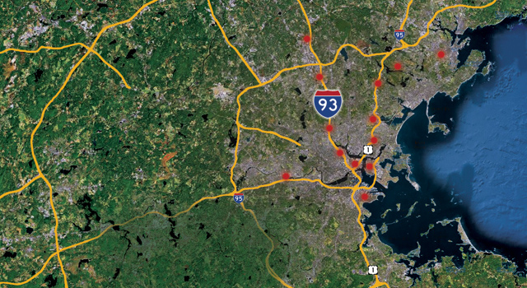
Communities in Boston Area Along Interstate Highways That Have the Highest Excess Mortality in Eastern Massachusetts

Slide 8
Tufts University Community Assessment of Freeway Exposure & Health (CAFEH) 2011 Doug Brugge
Out of 100 communities in eastern Massachusetts, the ones that have 75% excess mortalities are along interstate highways in the metropolitan Boston area and which have heavy vehicular traffic and high population density (Somerville, Mass Pop Den = 75,000 Per 4 Sq Miles).
HUD studies of indoor air quality find indoor air filtration devices resembling small window mounted air conditioners reduce indoor UFP by 35%.
NOAA studies found tall sound barriers actually contain most UFP inside highway boundaries.
University of California (UC Davis) found redwood trees can remove 80% of UFP. Alachua Co would have to find alternatives.

Slide 9
Alachua County Comprehensive Plan Considerations
Alachua County’s population will expand faster than anticipated in the next ten years largely driven by resettlement from the northeastern US and south Florida.
The growth of shopping opportunities will result in attracting residents from around the region resulting in ever increasing vehicular traffic.
A corresponding increase in diesel and non-diesel trucks will occur to meet supply and delivery needs.
Alachua County air and water pollution will increase with this inevitable growth.
Though the FDEP and the EPA are the sole regulators of air pollution, the county may be able to achieve some reduction in pollution through alternative measures.
Urban planning could include refinements in urban density, traffic optimization, incentivized car pooling and greater use of public transportation, strategically placed sound barriers for particulate containment, and the planting of trees and shrubs for particulate uptake.

Slide 10
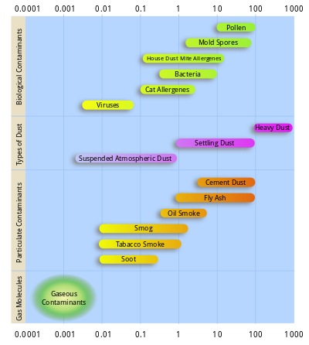
Particulate Matter: types and sizes in microns (10⁻⁶ m⁾
Notes:
This file is licensed under the Creative Commons Attribution-Share Alike license versions 3.0, 2.5, 2.0, & 1.0

Slide 11
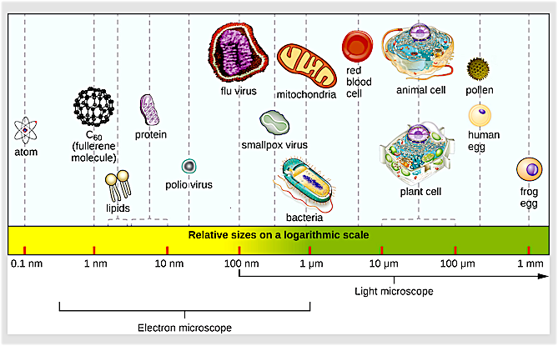
CELLS, VIRUSES, PM, MOLECULES, ATOMS
Notes:
J. Hulcr et al. “A Jungle in There: Bacteria in Belly Buttons are Highly Diverse, but Predictable.” PlosS ONE 7 no. 11 (2012)

Slide 12
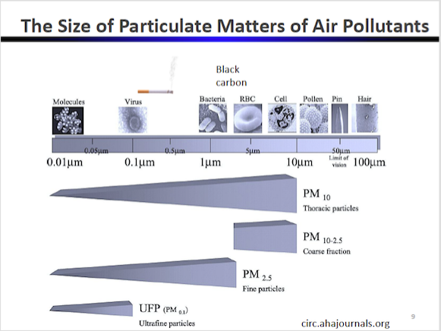

Slide 13
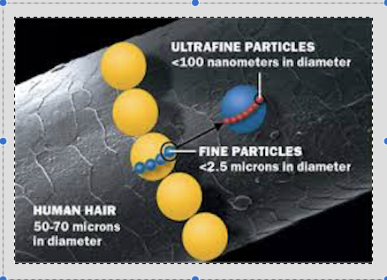
HUMAN HAIR, PM_{2.5} and PM₁
{Community Assessment of Freeway Exposure and Health (CAFEH) 2011 - Boston Metropolitan Area- Doug Brugge}
Notes:
Doug Brugge. “Assessment of Freeway Exposure and Health (CAFEH)” Tufts University August 2012

Slide 14
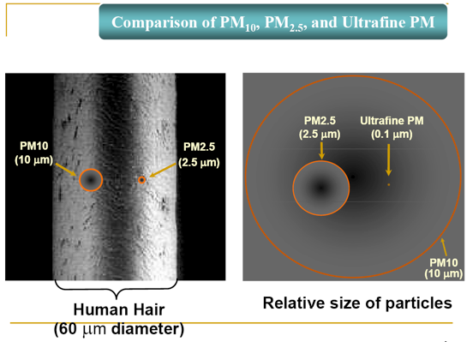
PM10, PM2.5, and PM.1

Slide 15
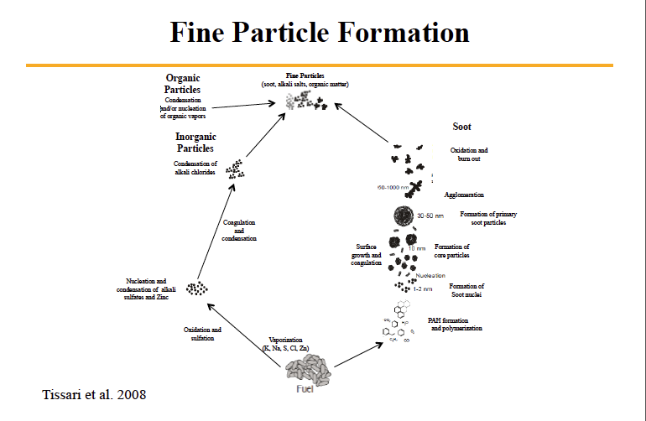
Combustion of fuel results in the formation of fine particulates that consists of a mix of materials undergoing different processes. Fine particulates collectively contain 1)soot, 2)alkali salts, 3) organic matter. Soot formation occurs thru the process of nucleation and coagulation of ultra fine particulate matter shown on the right side of this diagram. Inorganic particles consist of alkali sulfates and chlorides as shown on the left side of this diagram. A 3rd constituent, organic particles, are produced by the condensation and nucleation of organic vapors.

Slide 16
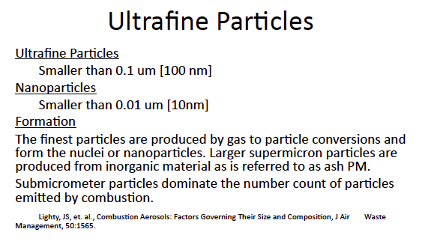
Ultrafine (PM_{0.1}) & Nanoparticles (PM_{.01})

Slide 17
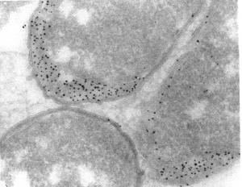
E. Coli Bacteria - Periplasmic Space labeled with 5 nm Immungold Particles Conjugated to 2nd° AB

Slide 18
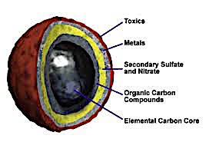
Diesel Soot Core Constituents

Slide 19
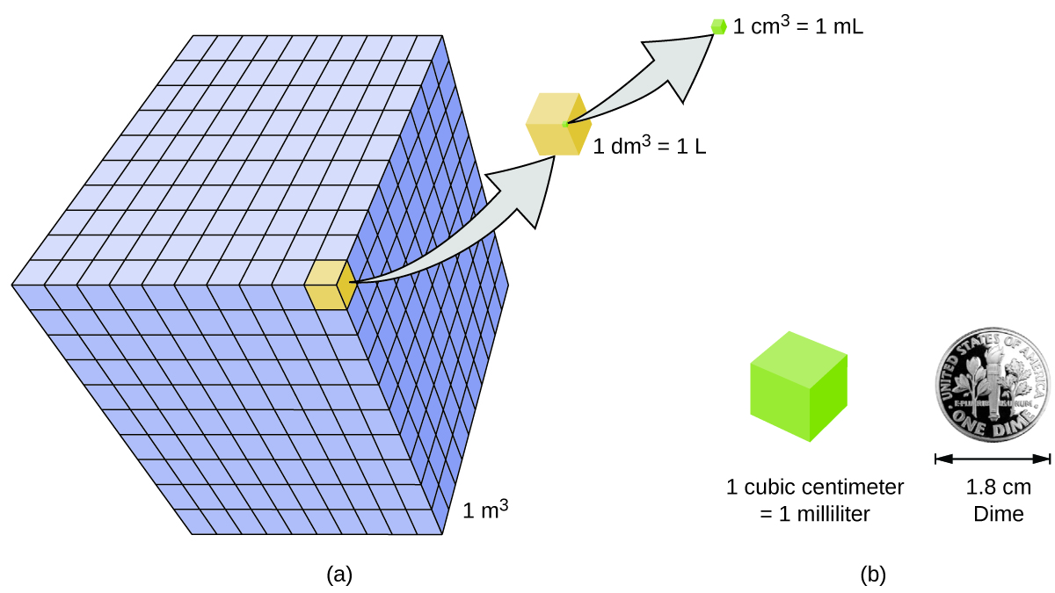
1 m³ = 1000 dm³ ⁼ 1,000,000 cm³, = 1,000,000 ml

Slide 20
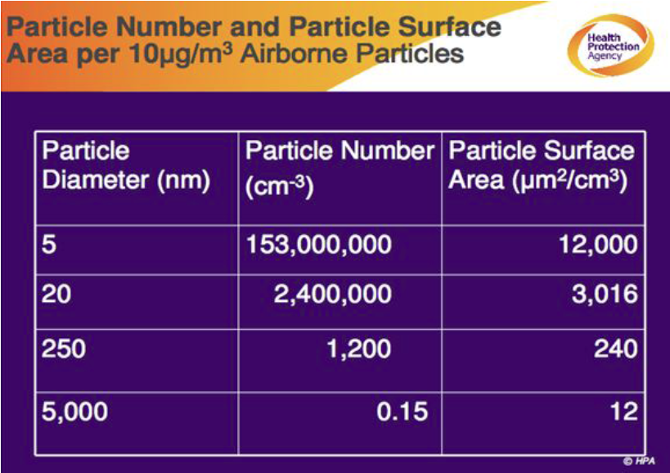
Particle Mass vs Particle Number and Surface Area
The EPA is monitoring & regulating by tons per year rather than by particle number. They are monitoring the wrong unit of measurement. The # of particles/unit volume is more important than the mass of particles/unit volume. Reason: smaller particles will have greater total surface area for a given mass and a given volume, and chemical reactions occur mostly by “surface interactions”. UFP (PM_{0.1}) have more surface area/unit wt. than PM_{2.5} and are therefore far more dangerous particles. Nanoparticles (PM_{.01}) are therefore even more dangerous. (chart from - http://www.npl.co.uk/upload/pdf/20100608_mansa_maynard_3.pdf)

Slide 21
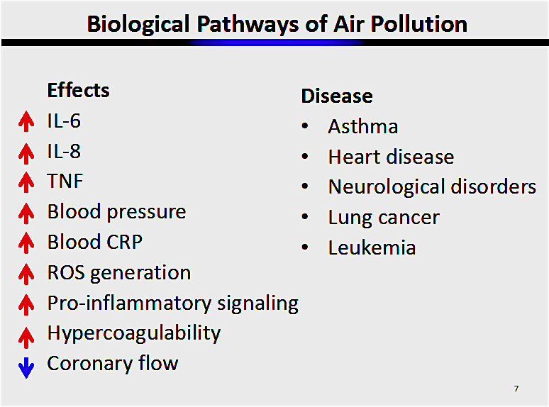

Slide 22
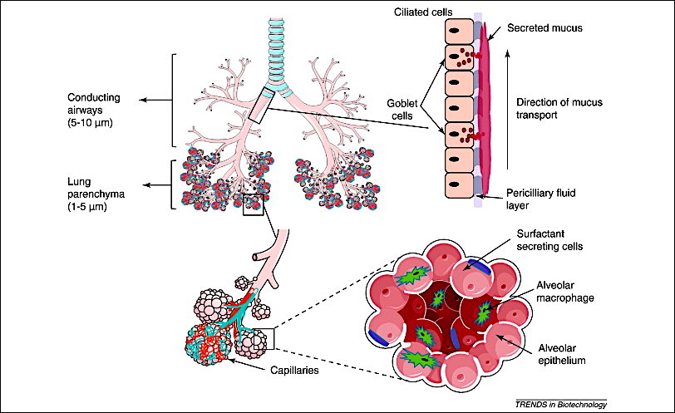
Lung Anatomy - Trachea, Bronchi, Bronchioles, Alveolar Sacs Contain Capillaries For Gas Exchange and an Entryway for PM1 (=1000 nanometers). Nano Particles (≤.01 micron≤ 10nm) Can Pass Through ALL cell membranes & Enter Mitochondria & even the Nucleus. The Nucleus is like a cell’s brain and Mitochondria are the Energy Factories.

Slide 23
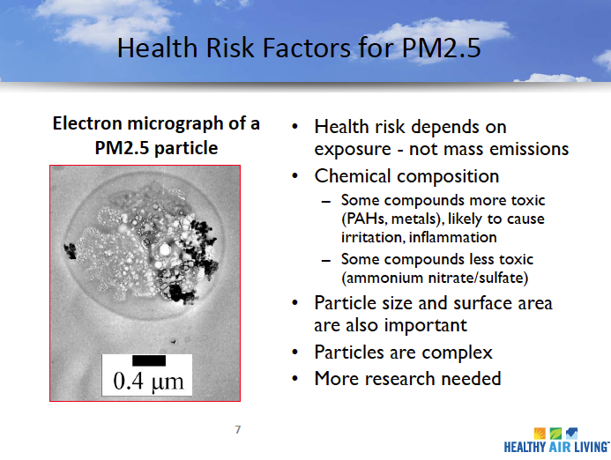
PM_{2.5} Often Contains a Variety of Chemicals Including Toxic Metals, PAH, PIC

Slide 24
Lung Anatomy - Trachea, Bronchi, Bronchioles, Alveolar Sacs Contain Capillaries For Gas Exchange and an Entryway for PM1 (=1000 nanometers). Nano Particles (.001 micron) Can Pass Through ALL cell membranes & Enter Mitochondria & even the Nucleus. The Nucleus is like a cell’s brain and Mitochondria are the Energy Factories.

Slide 25
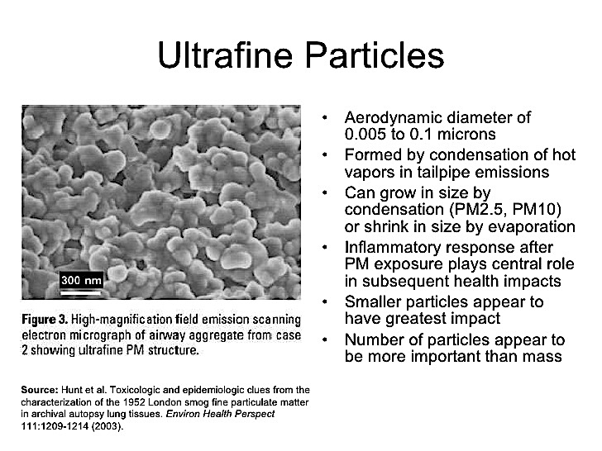
Toxicological & Epidemiological Clues from the Characterization of the 1952 London Smog Lung Autopsy Study – Hunt et al. Environmental Health Perspectives 111:1209-1214 (2003)

Slide 26
Innate & Adaptive Immune System’s role in inflammation
The Innate Immune System - recognizes a wide range of pathogens such as viruses, bacteria, and fungi, by evolutionary germline-encoded receptors known as pattern-recognition receptors (PRRs)
PRRs are expressed by a variety of immune cells, including macrophages, monocytes, and neutrophils, which enables early detection of pathogens
Acute inflammation can be caused by bacterial or viral infection (e.g., as in acute respiratory distress syndrome (ARDS), tissue necrosis (e.g., as in acute myocardial infarction), trauma, radiation, burns, or by any foreign body present in tissue.
The Adaptive Immune System - If the innate immune system exceeds its capacity or its defensive function becomes limited, it engages the Adaptive Immune System, activating specific T and B lymphocyte cells for pathogen clearance.
If this process is prolonged or inefficient, it progresses to the chronic state of inflammation that is associated with many diseases such as of the heart and rheumatoid arthritis.
Chronic inflammation is also associated with persistent bacterial infections such as tuberculosis, ARDS, autoimmune diseases, inflammatory bowel disease, atherosclerosis (heart disease), neurodegenerative diseases (dementia & Alzheimer's) and metabolic hormonal disorders( e.g. diabetes).

Slide 27
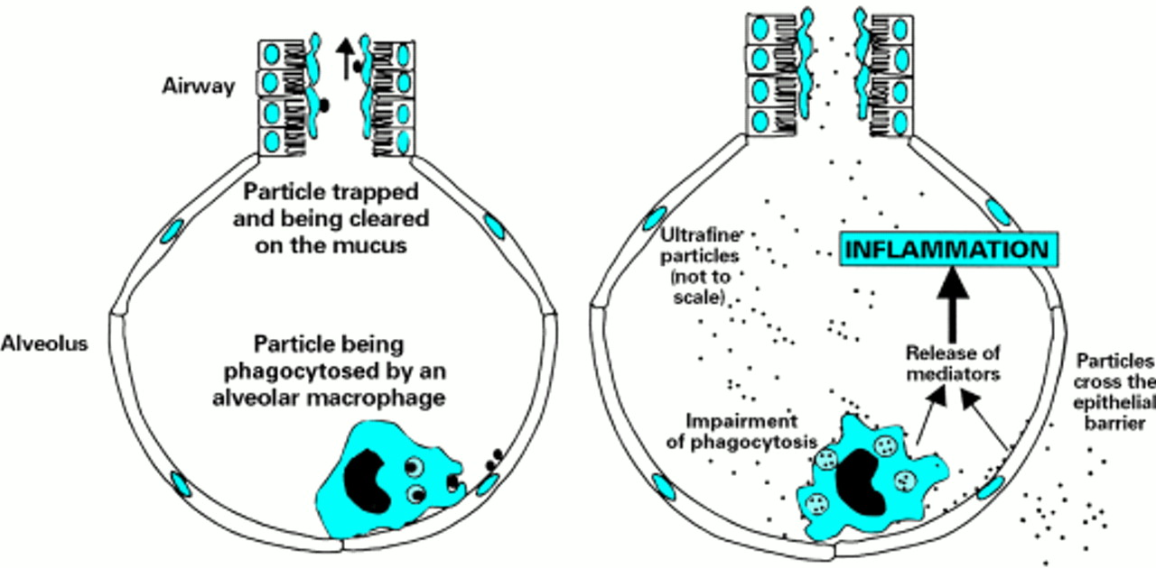
Inflammation in the Lungs caused by a Reaction to PM2.5 & PM.1 by Macrophages in the Alveolar Sac.

Slide 28
Toxicological & Epidemiological Clues from the Characterization of the 1952 London Smog Lung Autopsy Study – Hunt et al. Environmental Health Perspectives 111:1209-1214 (2003)

Slide 29
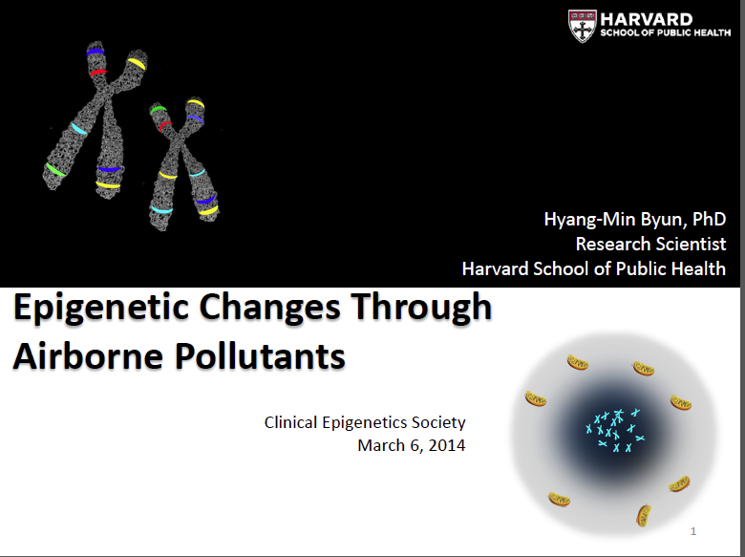
Notes:
Hyang-Min Byun, PhD, Res Scientist, Harvard School of Public Health, “Epigenetic Changes Through Air Pollution - 2014

Slide 30
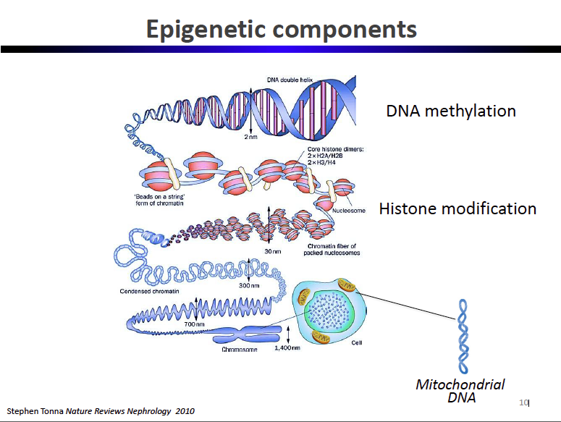
Mechanisms of Epigenetic Change

Slide 31
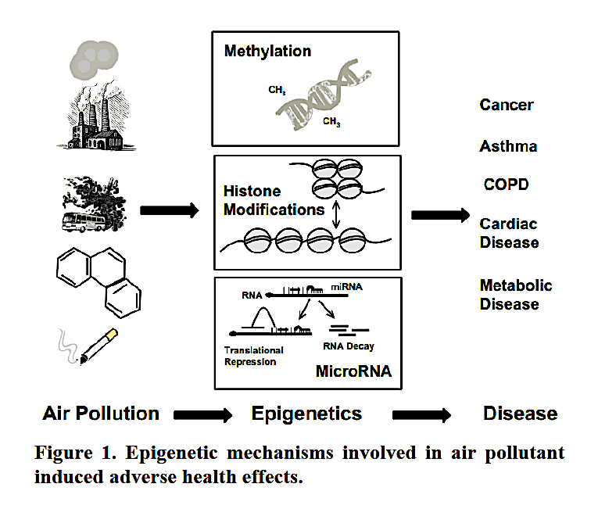
Epigenetic Mechanisms Involved in Air Pollutant Induced Adverse Health Effects

Slide 33
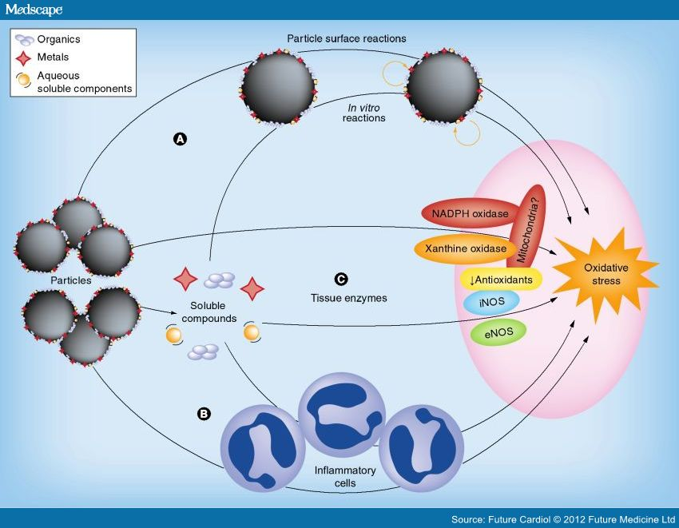
Oxidative Stress Caused By:
1) A Variety of Tissue Enzyme and Cytoplasmic Chemical Reactions as PM_{2.5}, PM_{.1}(UFP), & nanoparticles (PM_{.01}) Enter Tissues & Their Cells
2)Immune System Cells (Macrophages) Goble up Particles But Then Mount an Offensive Which Results in Chronic Inflammation & Leads to the Production of Reactive Oxygen Species, a Precursor to Many Disease Conditions.

Slide 34
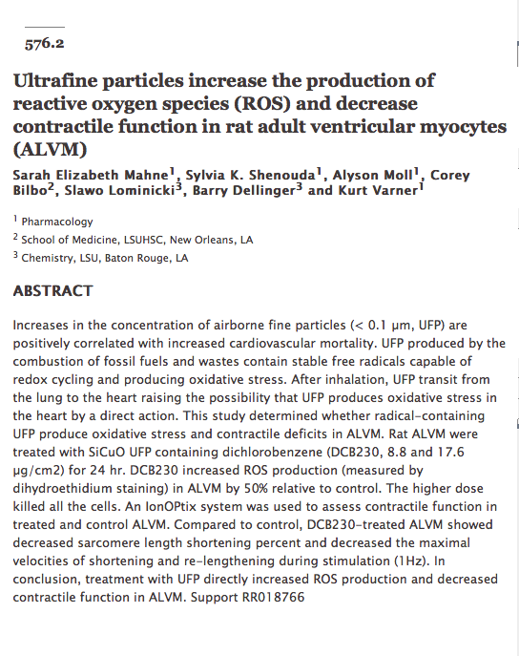
UFP (PM_{.1}) caused Increase production of reactive oxygen species (ROS) and decreased contractile function in ventricular heart muscle

Slide 35
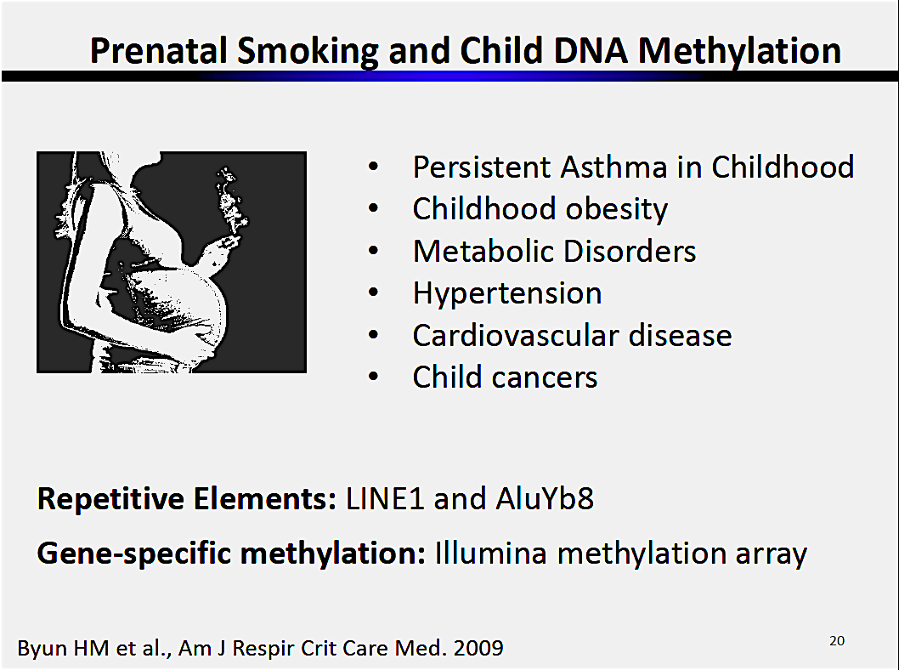
Prenatal Exposure to Tobacco Smoke Causes DNA Methylation, One of the 3 Epigenetic Mechanisms Related Diseases Caused by Smoking

Slide 36
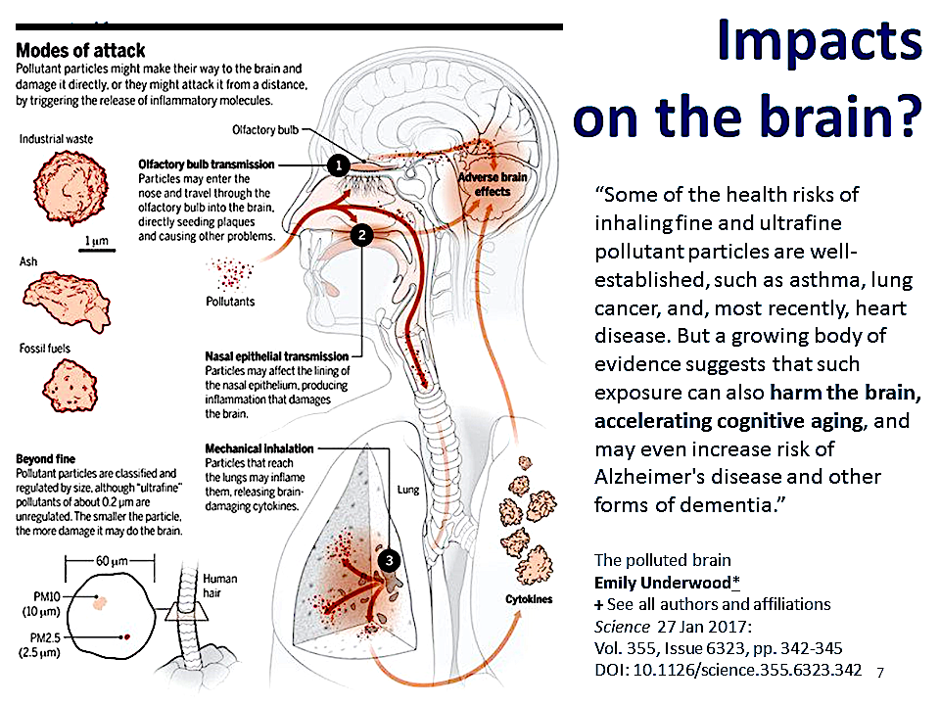
Bad News for All of Us Critters
The Polluted Brain- Science 27 Jan 2017: Vol. 355, Issue 6323, pp. 342-345

Slide 37
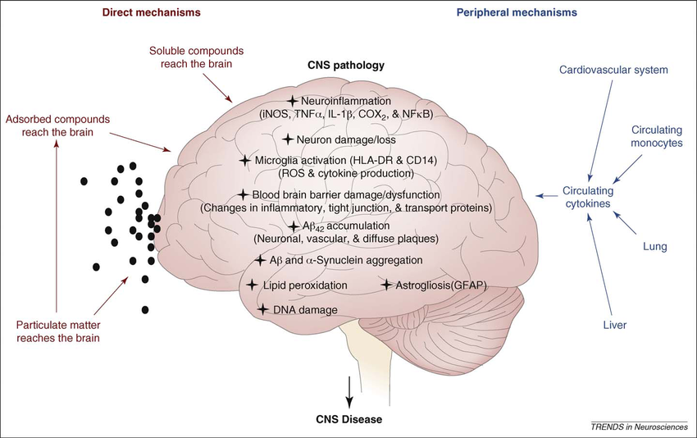
UFP (PM_{.1}), Nanoparticles (PM_{.01}) & Toxic Soluble Chemicals Cause Nerve Damage or loss, Neuro-inflammation, Oxidative Stress (via ROS),Blood Brain Barrier Damage, AB₄₂ Plaques, Lipid Peroxidation, Astriogliosis, DNA Damage

Slide 38
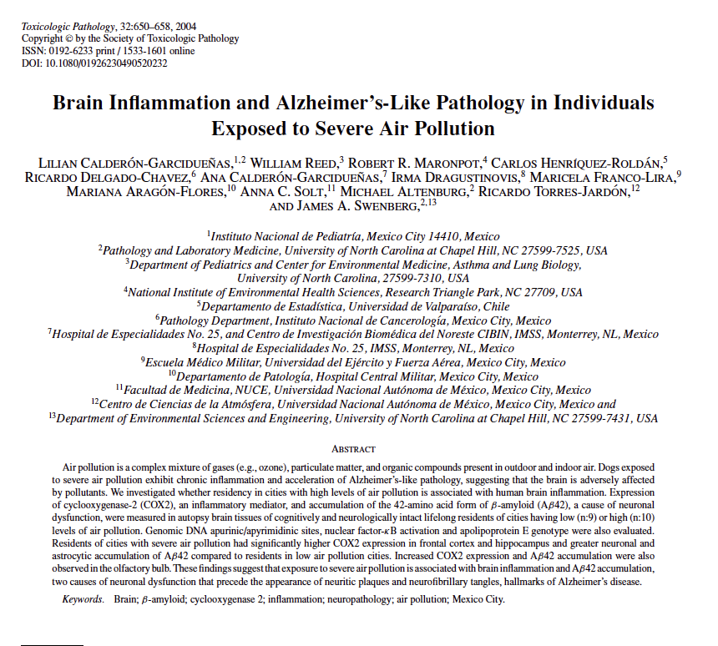
Evidence of Brain Inflammation & Alzheimer’s-Like Pathology in Individuals Exposed to Severe Air Pollution – B-amyloid(AB₄₂) Plaque Accumulation & Expression of Cyclooxygenase-2 (COX2) Which Causes Inflammation

Slide 39
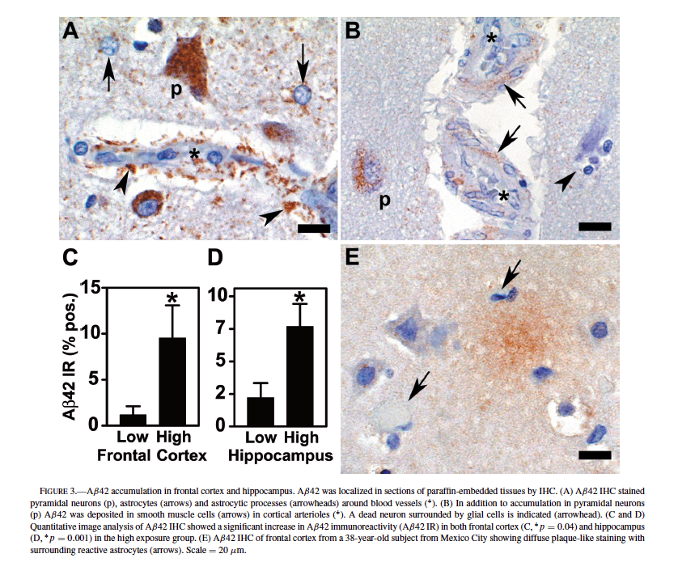
Beta amyloid protein (AB42) accumulation in human frontal cortex and hippocampus

Slide 40
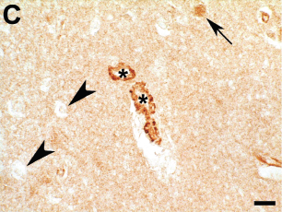
Immunostaining of pyramidal cells  & endothelial cells*lining capillaries in frontal cortex of human brain to detect the presence of inflammation caused by increased production of a pro inflammatory cell chemical, COX2 in autopsied human brains from people subject to long-term air pollution.

Slide 41
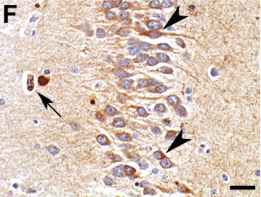
Immunostaining to demonstrate brain inflammation by COX2 expression in human neurons  & capillaries ↵. The scale is 15um

Slide 42
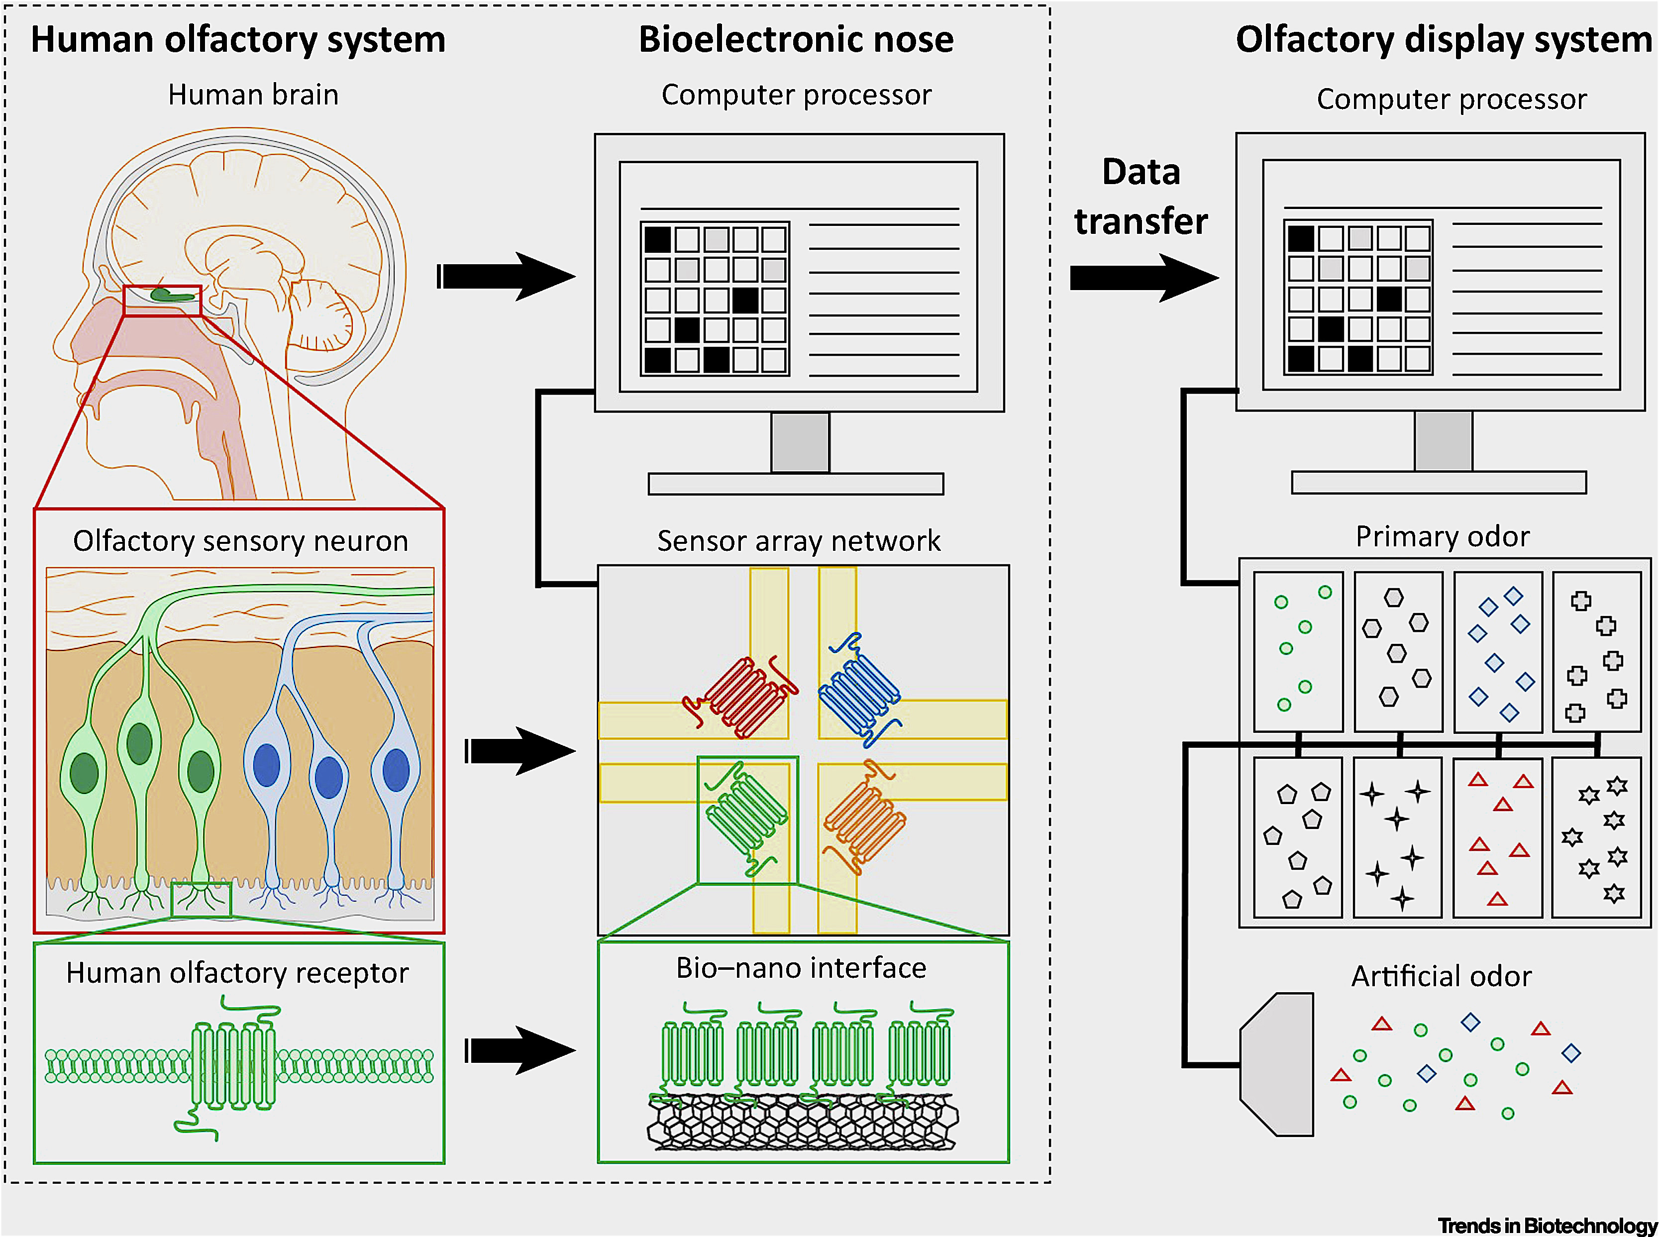
Bioelectric Nose With Computer Processor to Study the Effect of Air Pollution on the Olfactory Bulb in the Brain

Slide 43
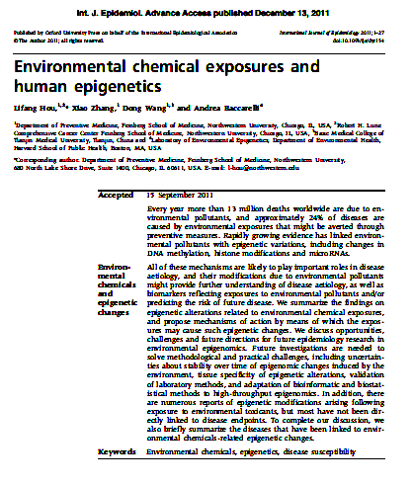
The Rosetta Stone of Epigenetic Studies on Chemically Induced Diseases – Lifang Hou et al, Journal of Epidemiology, Sept 15, 2011

Slide 44
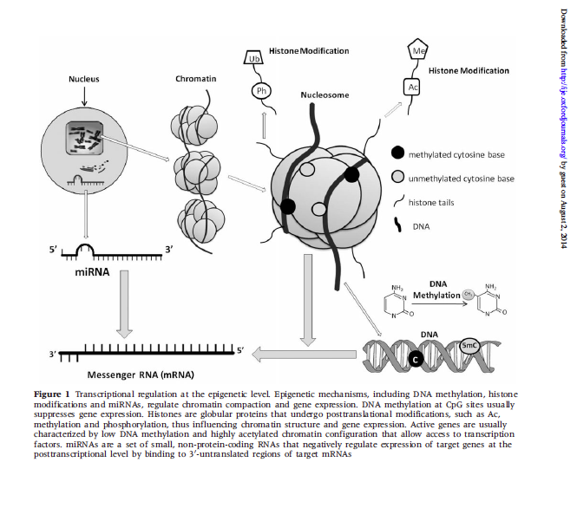
The 3 processes involved in epigenetic modifications, disease induction, and inheritance

Slide 45
Epigenetics is the study of heritable changes in gene function that do not involve changes in the DNA sequence of an organism.
Center for Disease Control and Prevention, found 148 different environmental chemicals were found in the blood and urine from the US population, indicating the extent of our exposure to environmental chemicals. Growing evidence suggests that environmental pollutants may cause diseases via epigenetic mechanism-regulated gene expression changes.
Furthermore, these changes may be preserved via Transgenerational epigenetic inheritance which is the transmission from one generation of an organism to the next without changing the DNA sequence, hence the term epigenetically.

Slide 46
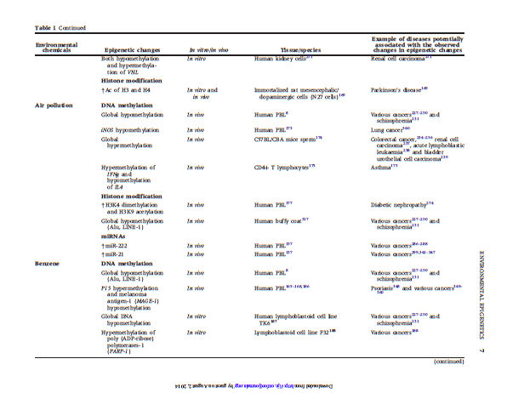
Epigenetic changes attributed to air pollution

Slide 47
Size Comparisons
1 meter = 39 inches = 100 cm = 1000 millimeters (mm) = 1,000,000 micrometers AKA micron (um)
1 inch = 2.54 cm = 25.4 mm
1 mm = 1/10 centimeter = 1000 microns
1 micron = 1 millionth (10⁻⁶) of 1 meter = 1000 nanometers (nm)
1 nanometer = 1 billionth (10⁻⁹) of 1 meter = 10 angstrom (A)
1 angstrom = 1 trillionth (10⁻¹⁰) of 1 meter = the limit of resolution of an electron microscope
Examples: H₂O molecule ~ 2.75 angstroms (A) = 0.275 nanometers (nm)
(PM) Fine- PM_{2.5} < 2.5 um, Ultrafine- PM_{.1} < 0.1 um, Nanoparticles < 0.01 um
Viruses = 20 - 400 nanometers (nm), bacteria = 1 to 4 microns (um),
Red blood cell (RBC) = 6 to 8 um, white blood cells = average about 15 microns (um)

